Slide 1
DISCRETE EVENT SIMULATION INVESTIGATION INTO THE IMPACT OF DISTINCT SERVICE RATE ATTRIBUTES OF SERVERS IN A MULTI-SERVER QUEUEING SYSTEM
BY
AYOBAMI VICTOR ALONGE¹, OMOTUNDE MUYIWA², OSITA ANYAECHE³

Slide 2
CONTENTS
Introduction
Literature Review
Methodology
Results
Discussion
Conclusion
Recommendation
References

Slide 3
Introduction
Queues are formed when rate of arrival of customers into the bank for processing of requests exceeds the rate at which the banking system processes the requests (Aronu et al., 2021).
Long waiting times lead to opportunity costs and loss of customer goodwill. Long waiting times inversely affect bank profitability (Harley et al., 2014).
Aim
To investigate impact of distinct server service rates in a multi-server queuing system processing requests of customers in a single waiting line using Discrete Event Simulation (DES).

Slide 4
Literature Review
Discrete Event Simulation (DES) imitates and models systems as distinct events at specific times (Software Solutions Studios, 2022).
Arena software is a leading DES tool with advanced features (Rashidi et al., 2016).
Various studies show DES effectiveness in optimizing queues, with most prior studies recommending adding more servers or increasing server speed.
Research gap
Most existing studies model queue systems with service times as a variable attributed only to customers, neglecting the possibility of service times being an attribute of the servers in the queue system.

Slide 5
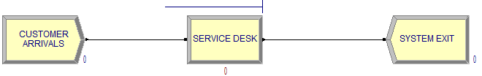
Methodology
Case study: Nigerian bank's customer-care section with 2 servers.
427 customer transactions observed during peak week, using a stratified purposive sampling technique.
DES model developed in Arena with 'Create', 'Process', and 'Dispose' modules.
Figure 1. Arena-DES model of the queue system of the customer-care section of selected bank
Source: Author
Three scenarios simulated: existing system of Server-1 and Server-2, Server-2 replaced with Server-1, and Server-1 replaced with Server-2.

Slide 6
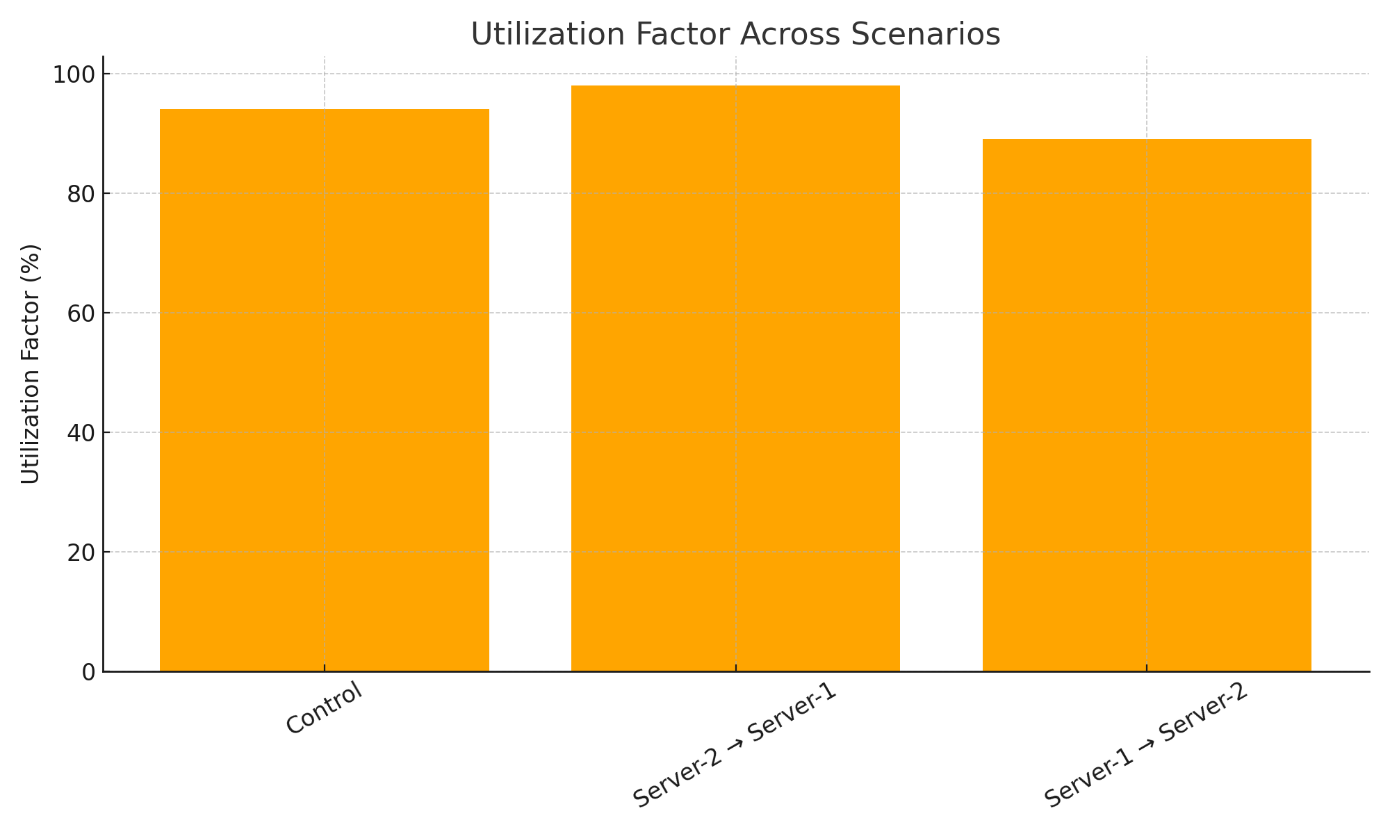
Utilization Factor Across Scenarios
Results

Slide 7
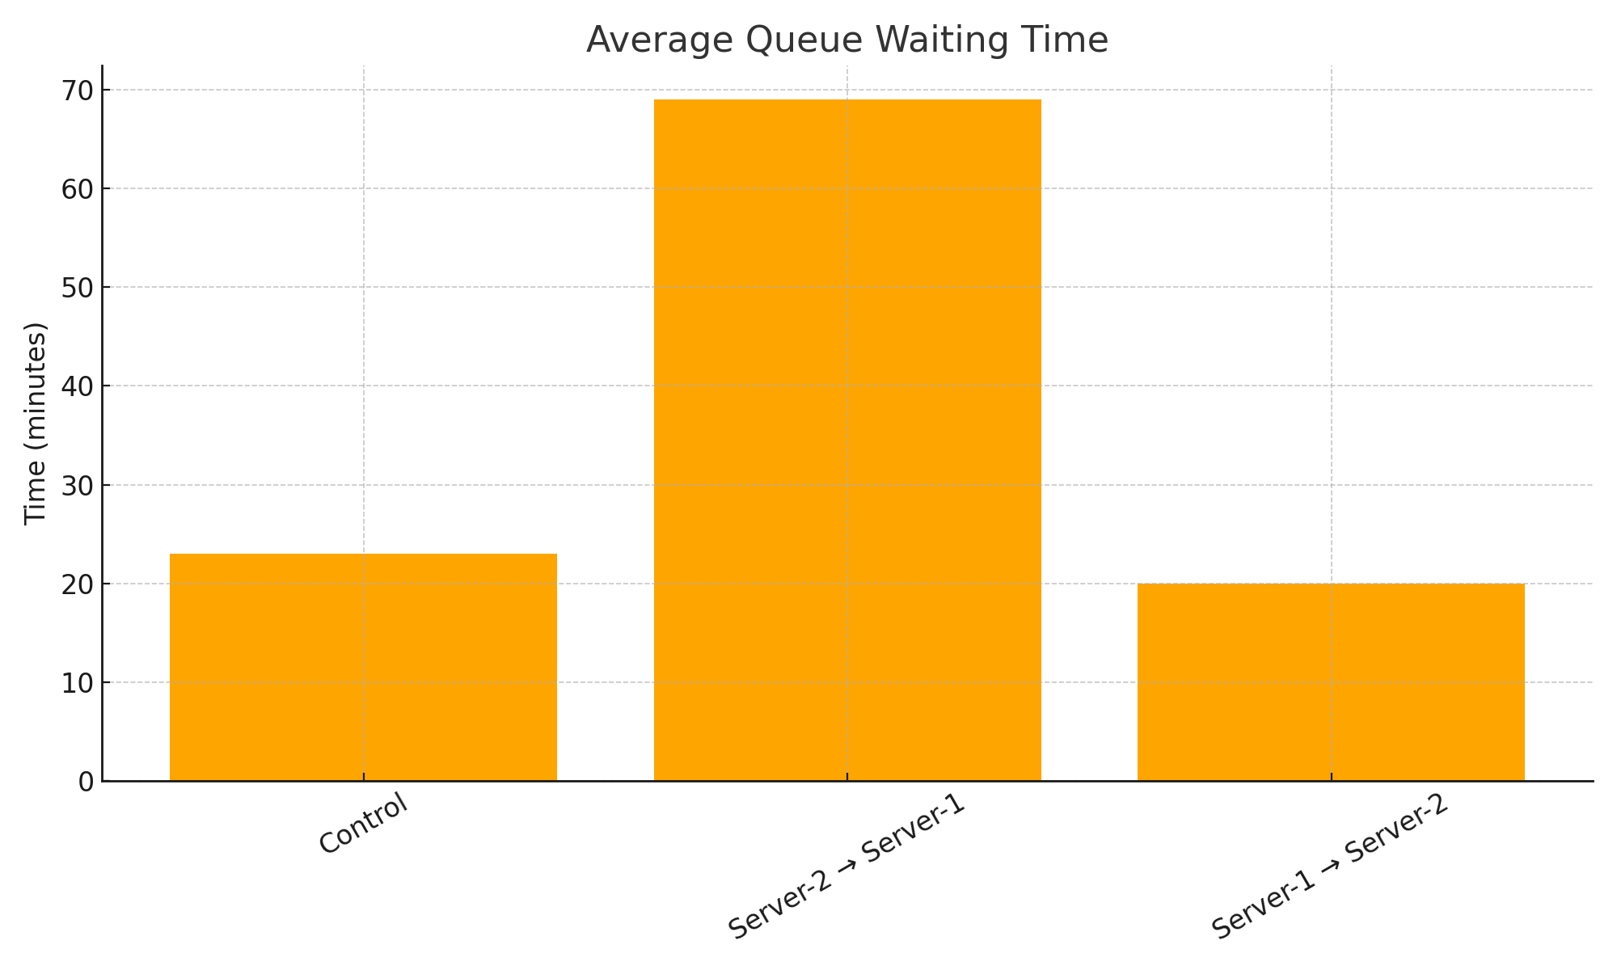
Average Queue Waiting Time

Slide 8
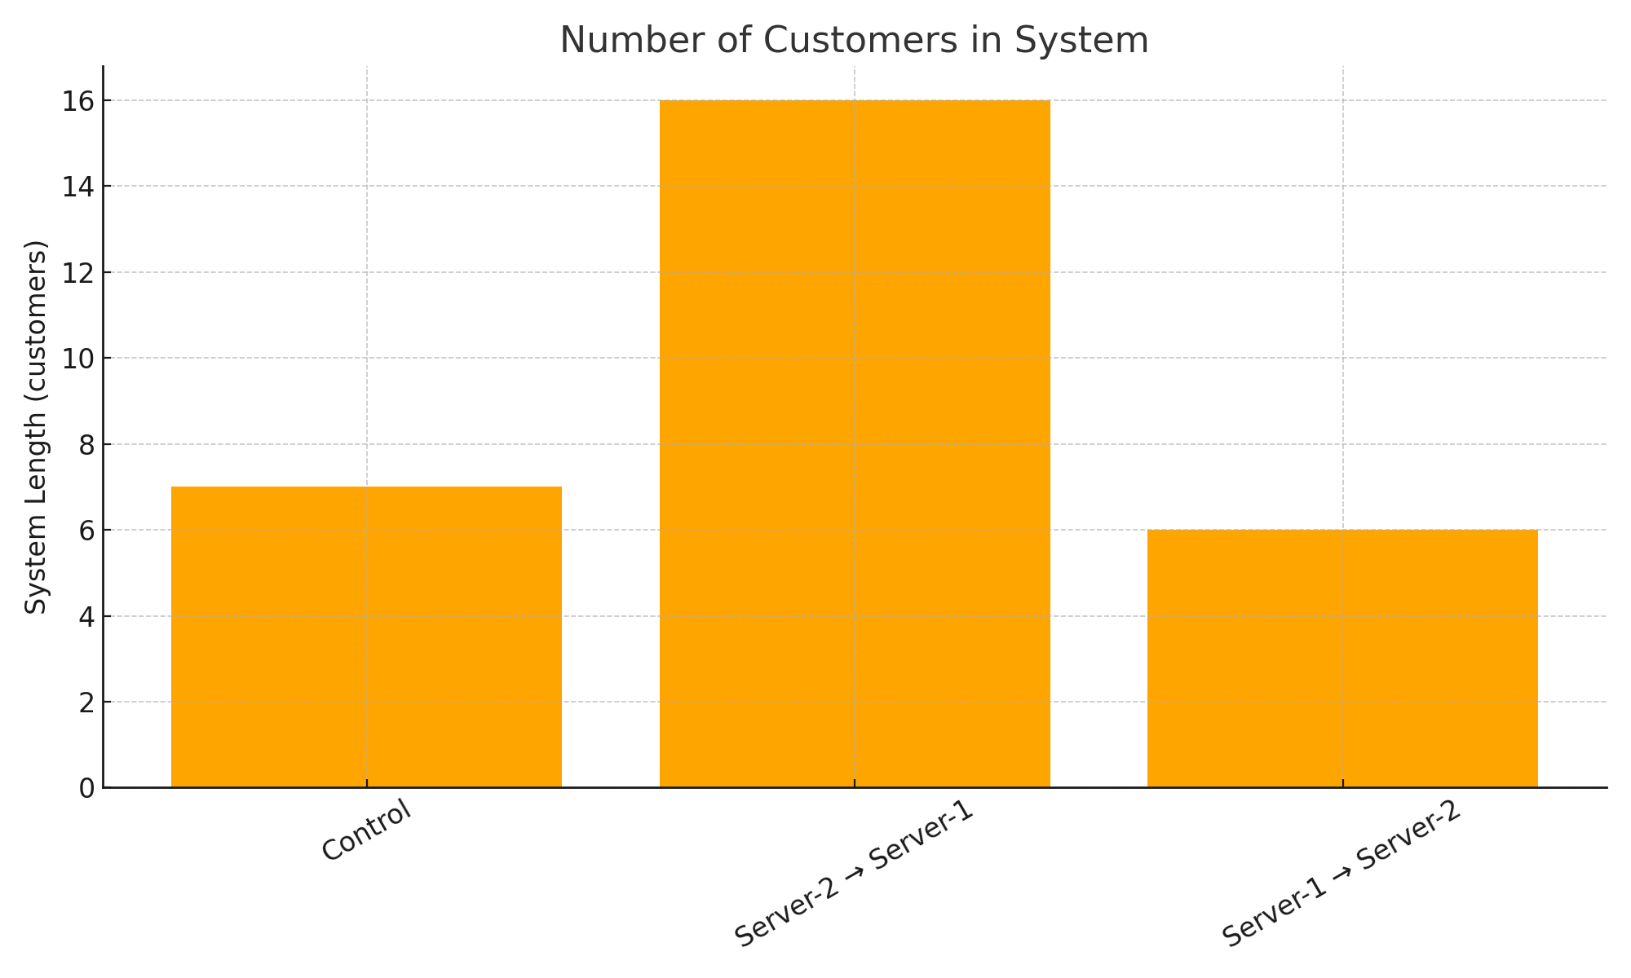
Number of Customers in System

Slide 9
Discussion
Control: 23.05 minutes average queue wait time, 32.42 minutes average system wait time.
Server-2 replaced by Server-1: average queue wait time increased to 68.63 minutes, average system wait time increased to 78.36 minutes.
Server-1 replaced by Server-2: average queue wait time reduced to 20.27 minutes, average system wait times reduced to 29.10 minutes.
Server-1 contributes more to longer wait times.
Server performance has significant impact on queue metrics.

Slide 10
Conclusion
DES effectively models queue systems in banks.
Server-1 replacement with a server having identical service rate attributes as Server-2 improves customer wait times.
Server attributes significantly influence system performance.
DES with Arena ensures reliable, evidence-based insights.

Slide 11
Recommendation
Banks should assess individual server performance regularly.
Consider DES as a tool for queue and staffing optimization.
Strategic personnel assignment can reduce wait times without extra staffing costs.
Future research should explore varied configurations and seasonal impacts.

Slide 12
References
Aronu, C. O., Onyeka, E. G. and Okoh, J. E. 2021. The assessment of Bank service performance in Delta State, Nigeria: Queueing Theory Approach. Further Applied Mathematics 1.1: 10-25. Retrieved from https://www.researchgate.net/publication/350994632
Harley, T. W., Samson O. and Joseph O. I. 2014. An Empirical Analysis of Effective Customers Service on Nigeria Banks Profitability: A Queuing and Regression Approach. Asian Economic and Financial Review 4.7: 864-876. Retrieved from https://www.researchgate.net/publication/281032000
Rashidi, Z. and Rashidi, Z. 2016. Evaluation and Ranking of Discrete Simulation Tools. Journal of Electrical and Computer Engineering Innovations JECEI 4.1: 69–84. Retrieved from https://doi.org/10.22061/jecei.2016.562
Software Solutions Studio. 2022. A gentle introduction to discrete-event simulation. Retrieved from https://softwaresim.com/blog/a-gentle-introduction-to-discrete-event-simulation

